Slide 1
CRAFT HIVE
PROJECT GUIDE: PROF.JAYA JOHN
ASST.PROFESSOR
DEPT OF CSE
TEAM NO:9
MEMBERS:AKHIL SANKHER S (S6 CSEB 04)
ALLEN ALEX ALANEY(S6 CSEB 08)
RIA SIBY(S6 CSEB 52)
RINTA MARIA RAJU(S6 CSEB 53)

Slide 2
CONTENTS
PROBLEM STATEMENT
PROJECT SCOPE
REQUIREMENT ANALYSIS
DESIGN
MODULE DESCRIPTION
TECHNOLOGY STACK
GANTT CHART

Slide 3
PROBLEM STATEMENT
Small scale craft makers are not recognized much. Nowdays most of these makers sell there products through SNS platforms like Instagram , facebook etc .
But here the competition is high , Those at the top with more followers and sponsers get more reach on these platforms but other’s works are not recognized much and it is a waste of time and money for them.

Slide 4
PROJECT SCOPE
To provide a platform for small scale craft makers to sell their products and create a convenient and easy to use application for users.
The Application will be able to perform the following operations:
Add and Delete products: This feature allows seller to add and delete products based on the availability of product.
Review Products: This feature allows buyers to share their opinion about the product they bought.
Payment And Refund: This feature allows the buyer to pay. If the buyer cancels the order the amount is refunded to them, For customized product the buyer have to pay an advance amount and if they cancel the order no refund is given.
Customized Products: This feature allows the buyer to ask for customized product. A feature for chatting with seller is also provided in the case of customized product.

Slide 5
REQUIREMENT ANALYSIS

Slide 6
DATA COLLECTION
The data was collected through:
Surveys: Conducts surveys with small scale craft makers to gather their feedback and insights.
Social Media Listening: Monitor social media platforms , forums and online communities related to crafts to understand the challenges discussed by small scale craft makers.
The data was collected from:
Small scale craft makers themselves: We contacted small scale craft makers in our friend circle and identified the issues they face.
Academics and Researchers: Academics and researchers in fields such as arts and crafts, design, cultural studies, economics, and sustainability identify problems related to small scale craft makers through their research and studies.
Local Communities and Consumers: Consumers who appreciate handmade products and support small scale craft makers may identify problems related to accessibility, affordability, and availability of craft products.

Slide 7
FUNCTIONAL REQUIREMENTS
Hardware Requirements
RAM:4GB and above
Processor: Pentium Processor and above
Software Requirements
Front end: HTML 5.0,CSS,React.js
Back end : node.js , MongoDB
User registration and login: The website should allow users to create accounts and login securely.
Search and filtering: Buyers should be able to search for products using keywords and filter by various criteria such as price range, product category, brand, and other relevant attributes
Product catalog: The platform should have a catalog of products that sellers can list and buyers can search and browse. The catalog should have details such as product descriptions, images, price, and stock availability

Slide 8
Shopping cart and checkout: Buyers should be able to add products to their shopping cart and proceed to checkout, where they can review their order, select a payment method, and provide shipping details.
Product Customization: A chatting platform is provided for customized products
Payment processing: The platform should facilitate secure payment processing, allowing buyers to pay for their orders using payment gateways.
Order management: Sellers should be able to manage their orders, updating the status of orders.
Reviews and ratings: Buyers should be able to leave reviews and ratings for products and sellers, which can help other buyers make informed decisions and also help sellers improve their products and services.
Account management: The website should allow users to update their account information, manage their addresses, and update their payment methods.

Slide 9
NON FUNCTIONAL REQUIREMENTS
Performance Requirements
Maximum possible quick response to the orders is required, also should provide fast updation of records. The changes if any made should be reflected automatically in the next screens. In order to maintain an acceptable speed at maximum number of uploads allowed from a particular customer as any number of users can access to the system at any time. Also the connections to the servers will be based on the attributes of the user like his location and server will be working 24X7 times.
Safety Requirement
Payment security: Ensure that the payment process is secure and encrypted. Use trusted payment gateways, which have their own security measures in place.
Strong passwords: Use strong passwords and change them regularly to prevent unauthorized access to your account.

Slide 10
3. Privacy policy: Make sure that the online shop has a clear and transparent privacy policy, which outlines how they collect, store, and use your personal information.
Software Quality Attributes
Security: The application is password protected and also any updation of new product entries and order processing is done by only privileged users.
Maintainability: The application is to be designed so that it is easily maintained. Also it should allow incorporating new requirements in any module of system.
Reliability: The application will be able to handle two orders. When a user confirms his/her order the database will be updated immediately and the next user will not face problems in ordering.
Portability :The application will be easily portable on any window based system.

Slide 11
DESIGN

Slide 12
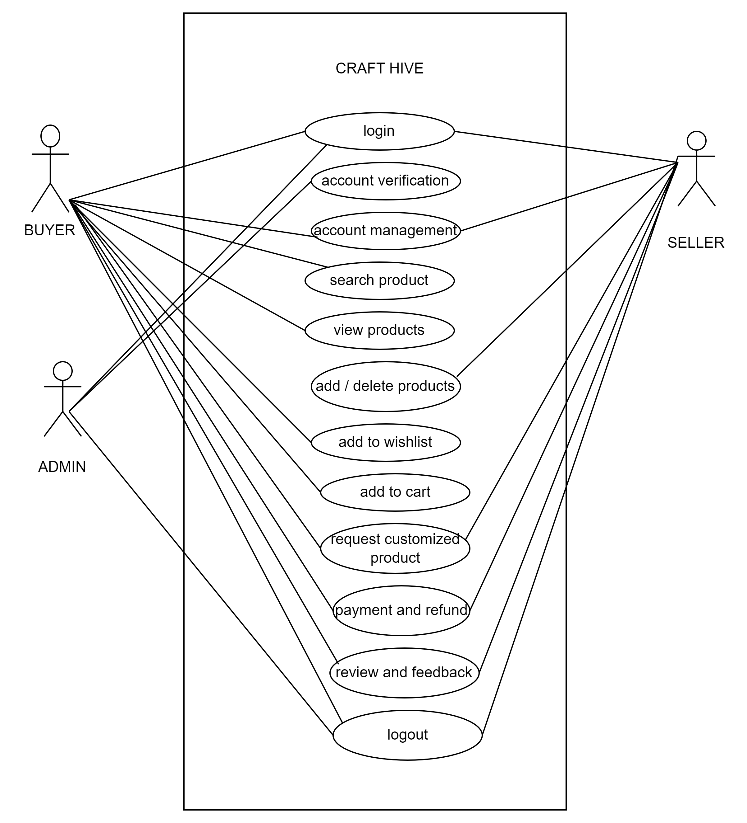
USE CASE DIAGRAM

Slide 13
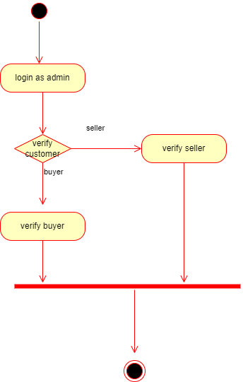
ACTIVITY DIAGRAM
FOR ADMIN

Slide 14
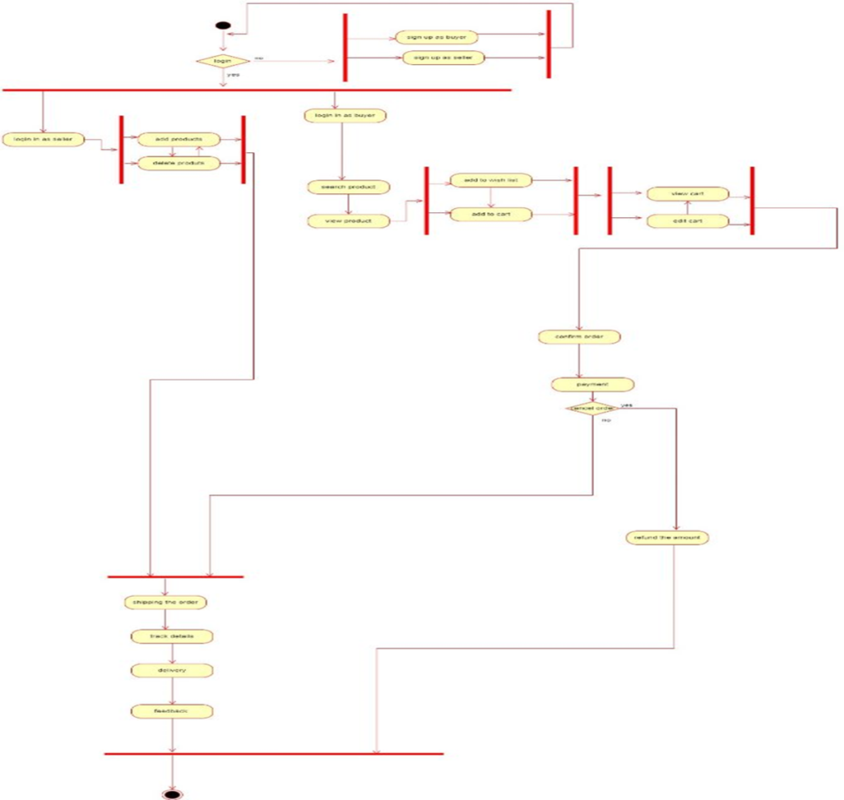
FOR USER(NOT CUSTOMIZED PRODUCT)

Slide 15
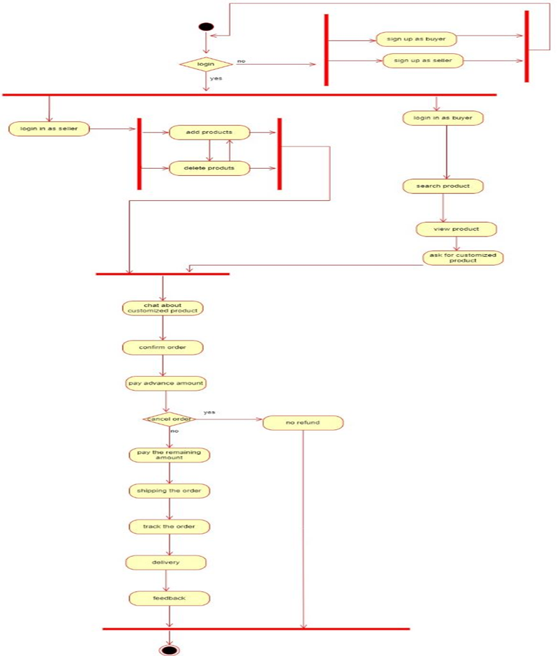
FOR CUSTOMIZED PRODUCT

Slide 16
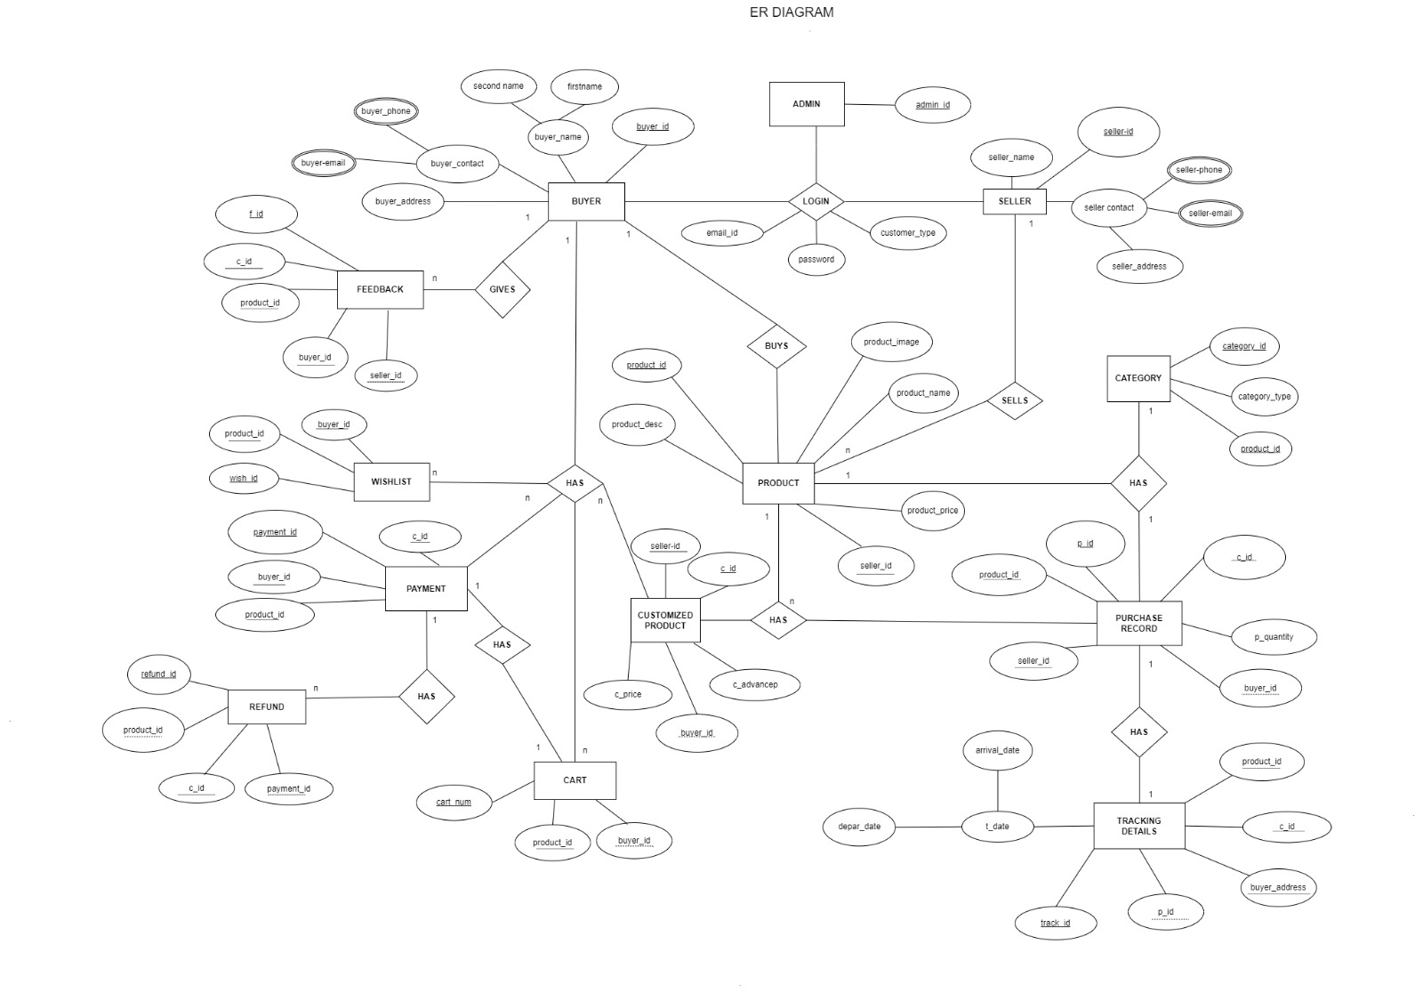
ER DIAGRAM

Slide 17
MODULE DESCRIPTION
User Module
Login Page : The end-user of the online shop can login.
Browsing Product : A user action that allows them to browse through the available products in the online shop.
Online Shop
Product Catalogue : A database containing all the products available for purchase
Cart : A temporary storage area where customers can keep items they intend to purchase
Customized Product Request : Buyer can request a product to be customized for there need .
Chat Box : For describing the change they need with the craftsmen

Slide 18
Payment
Payment Gateway : An interface that allows the online shop to securely process payments from customers.
Payment Processing : A service that processes payments on behalf of the online shop.
Orders
Order Management : A database containing information about all orders placed in the online shop.
Order Status : Status about where order shipped or not.
Analytics
Feedback : About the product
Data Management : Management of all the data in the database.

Slide 19



TECHNOLOGY STACK
TOOLS_REQUIRED
1. HTML 5.0 2. CSS 3. REACT.js

Slide 20


4. Node.JS 5. mongoDB

Slide 21
GANTT CHART

Slide 22
THANK YOU

